Slide 1
House Price Prediction Project
By: Tomas H, Rita E, Sandra N, Ihechi D

Slide 2
Why did we choose this topic?
Hot topic!🔥
The housing market is widely talked about, especially since the start of the COVID-19 pandemic.
Impact
We are all impacted by the housing market in one way or another so this is an important topic for us.

Slide 3

Questions we plan to answer
How accurately can a model predict the sale price of a house?
What are the most important features that can impact the price of a house?

Slide 4
Dataset Used: Real dataset of house prices sold in Seattle, Washington, USA between August and December 2022
Seattle, Washington

Slide 5
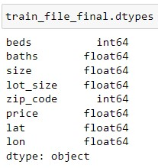
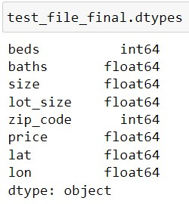
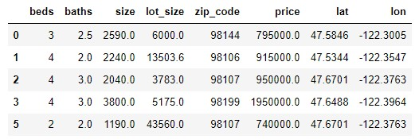
Dataset Description
First dataset: Well-structured testing and training CSV files from Kaggle (dataset link)
8 columns: ‘beds’, ‘baths’, ‘size’, ‘size_units’, ‘lot_size’, ‘lot_size_units’, ‘zip_code’, and ‘price’
Target column is ‘price’, and all other columns are the features
Second dataset: All Zip Codes in the United States with their coordinates (dataset link)
Used VLOOKUP in Excel to find the corresponding coordinates (‘lat’, ‘lon’) from the second dataset to the Zip Code in the first dataset (testing and training files)
File was then merged with the testing and training files using Pandas to create the final Data Frame

Slide 6


Tools & Technologies
Visualization: Tableau, Seaborn, Matplotlib
Data Analysis: Jupyter Notebook, Excel
Algorithms: Linear Regression, Random Forest Regression, k-Nearest Neighbours (k-NN)

Slide 7
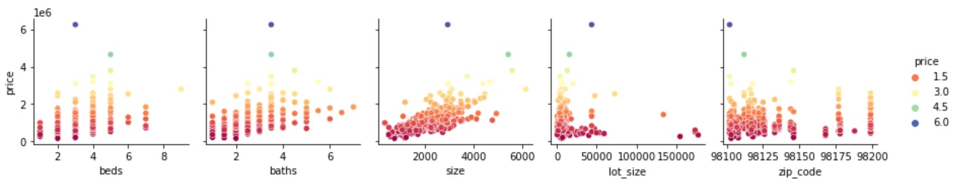
Data Exploration Phase
Using Seaborn, we were able to gather insights on the relationships between factors by creating different types of diagrams.
Pairplot
Diagrams showing price against the different features.

Slide 8
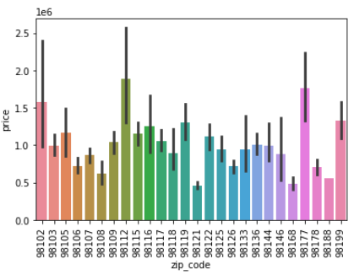
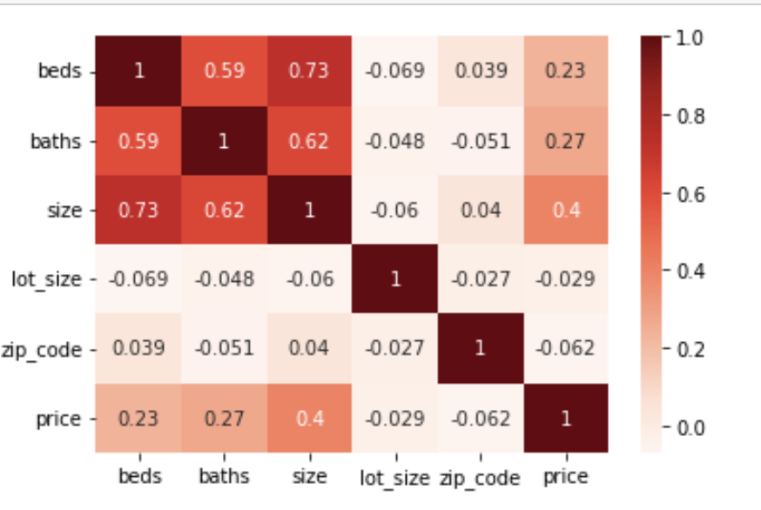
Data Exploration Phase Cont.
Bar Plot
Heatmap
Bar plot illustrating the relationship between price and zip codes.
Heatmap showing correlations between each of the features.

Slide 9
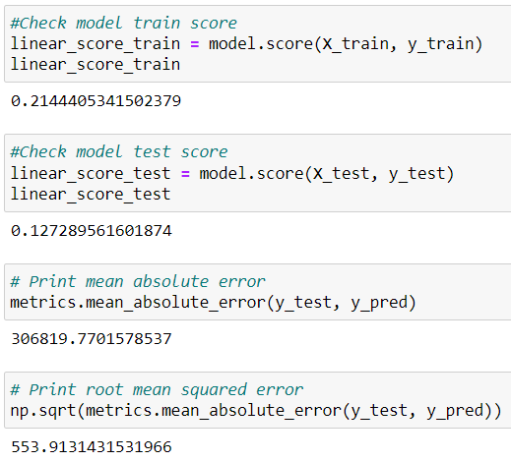
Analysis Phase
Our linear regression model performed poorly overall with a model train score of 0.21 and test score of 0.13.
The mean absolute error (MAE) was also very high with a score of 306819.77 and a root mean squared error (RMSE) of 553.91.
While we are not satisfied with these scores, we achieved our goal of building a simple functioning model for deliverable 2.
For deliverable 3, we plan to use scaling, adding more features, and trying different models to determine the best model to use.

Slide 10
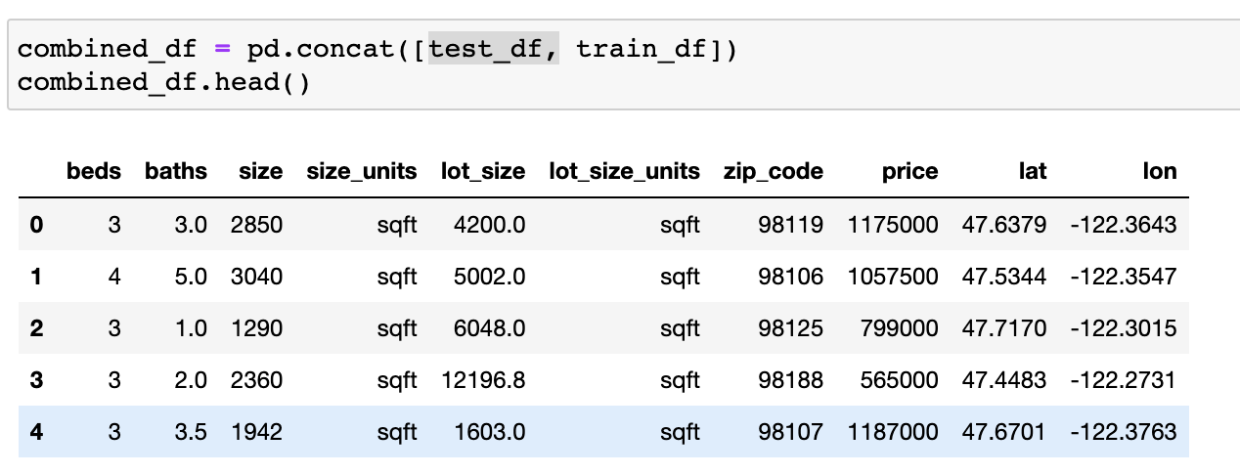
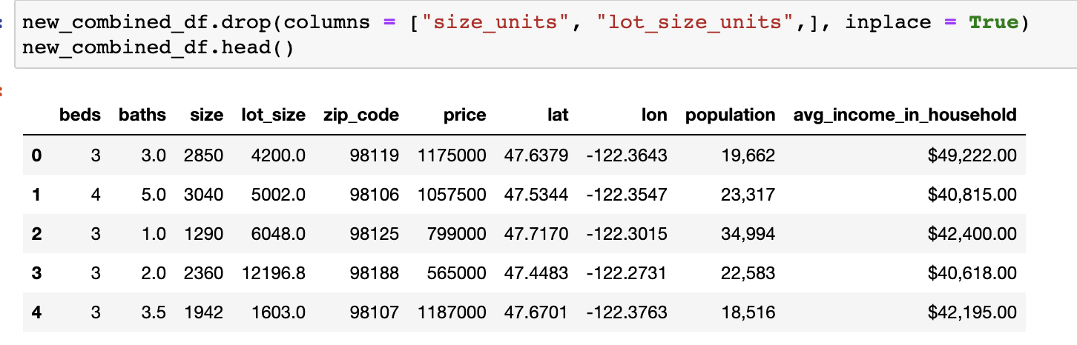
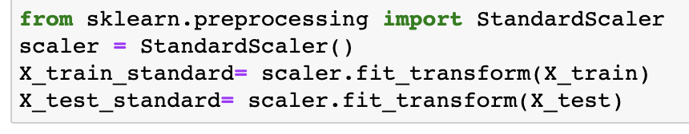
Part 2:Analysis Phase
A few changes were made to improve the model, which includes:
Combining the train and the test data frame to create our own split for the model.
New features were added: Population and Average Income Per Household.
The X values of the data were scaled.

Slide 11
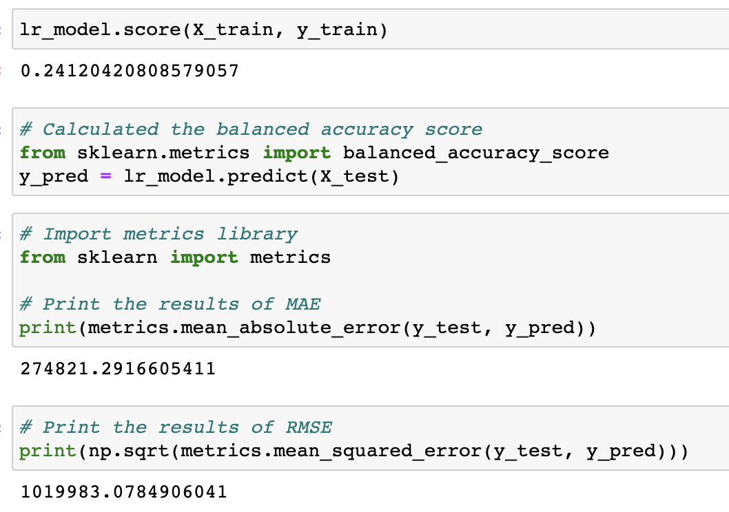
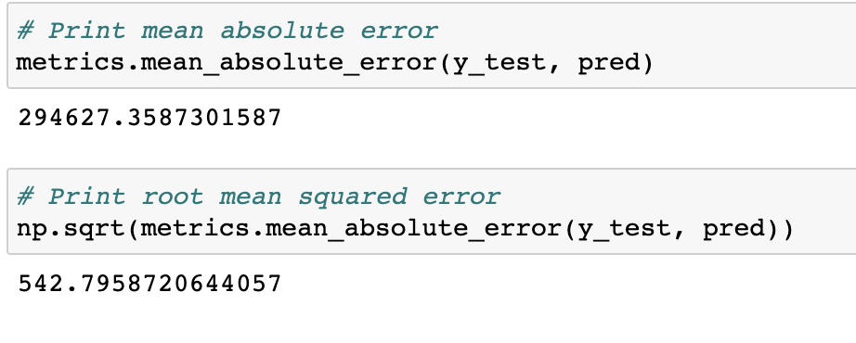
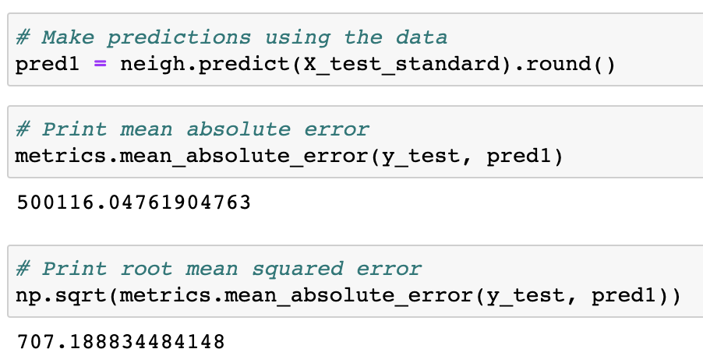
Results
1.
Linear Regression model: the model score is 24%. It is still poor but there is a slight improvement compared to the previous result we attained. The mean absolute error is approximately 274821.3 with the root mean squared error of approximately 1019983.08.
Random Forest model: the mean absolute error was approximately 294627.4 and the root mean squared error was approximately 542.80.
KN Regression model: The mean absolute error was approximately 500116.05 and the root mean squared error was approximately 707.19.
2.
3.

Slide 12
Future Analysis Recommendations
Evaluate the performance of the model by adding and removing different features.
Testing and comparing newer models.
Evaluating the model using multiple train/test split to improve performance.
Combining multiple models instead of using a single model for prediction.

Slide 13
Ideas that can be done differently
Continue developing the model to achieve a higher accuracy score.
Build a more complex dashboard with more diagrams.
Adding/dropping more features based on importance for the model.
Using a different dataset that is larger and contains a longer time span.

Slide 14
THANKS!
Any questions?
Please email or message us on Slack.

